Slide 1
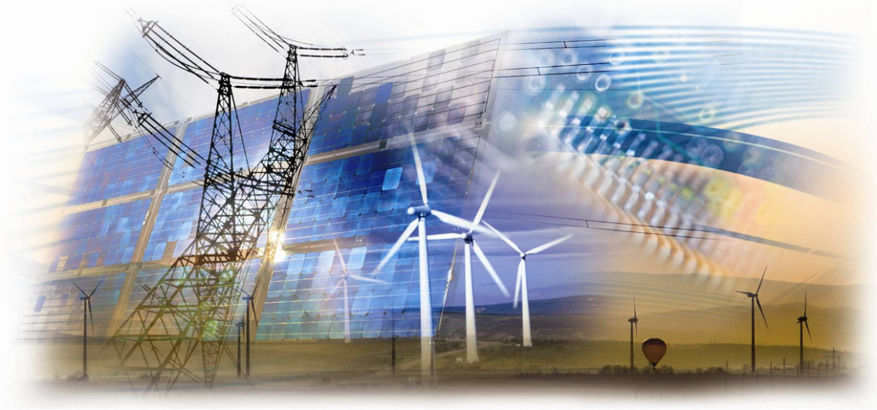
Smart grids
Identifying and Resolving Major Problems within the Smart Grid System
ABHISHEK GUATAM
abhishek240196@outlook.com
+91 8750810005

Slide 2
Cyber Physical System
NEW GENERATION
OF SYSTEM WITH
INTEGERATED
COMPUTATIONAL AND PHYCIAL CAPABILITIES THAT CAN
INTERACT
WITH HUMANS THROUGH
NEW MODULARITIES

Slide 3
The ability to interact with and expand the capabilities of physical world through computation, communication and control is the key enabler for future technology developments !

Slide 4
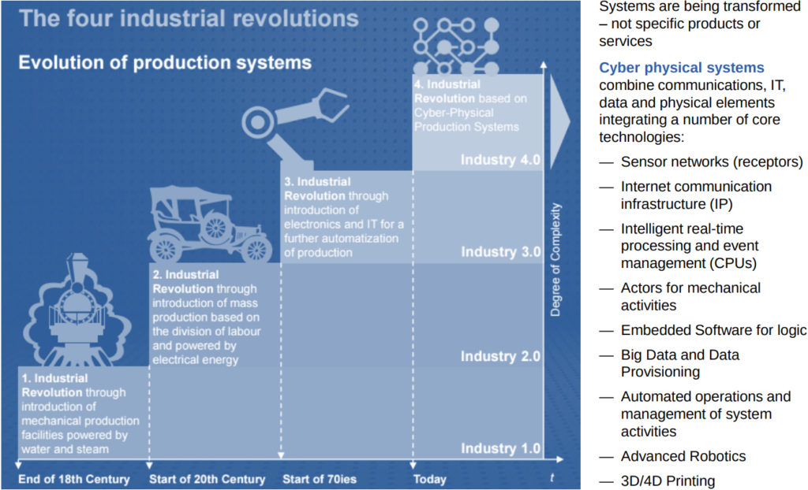

Slide 5
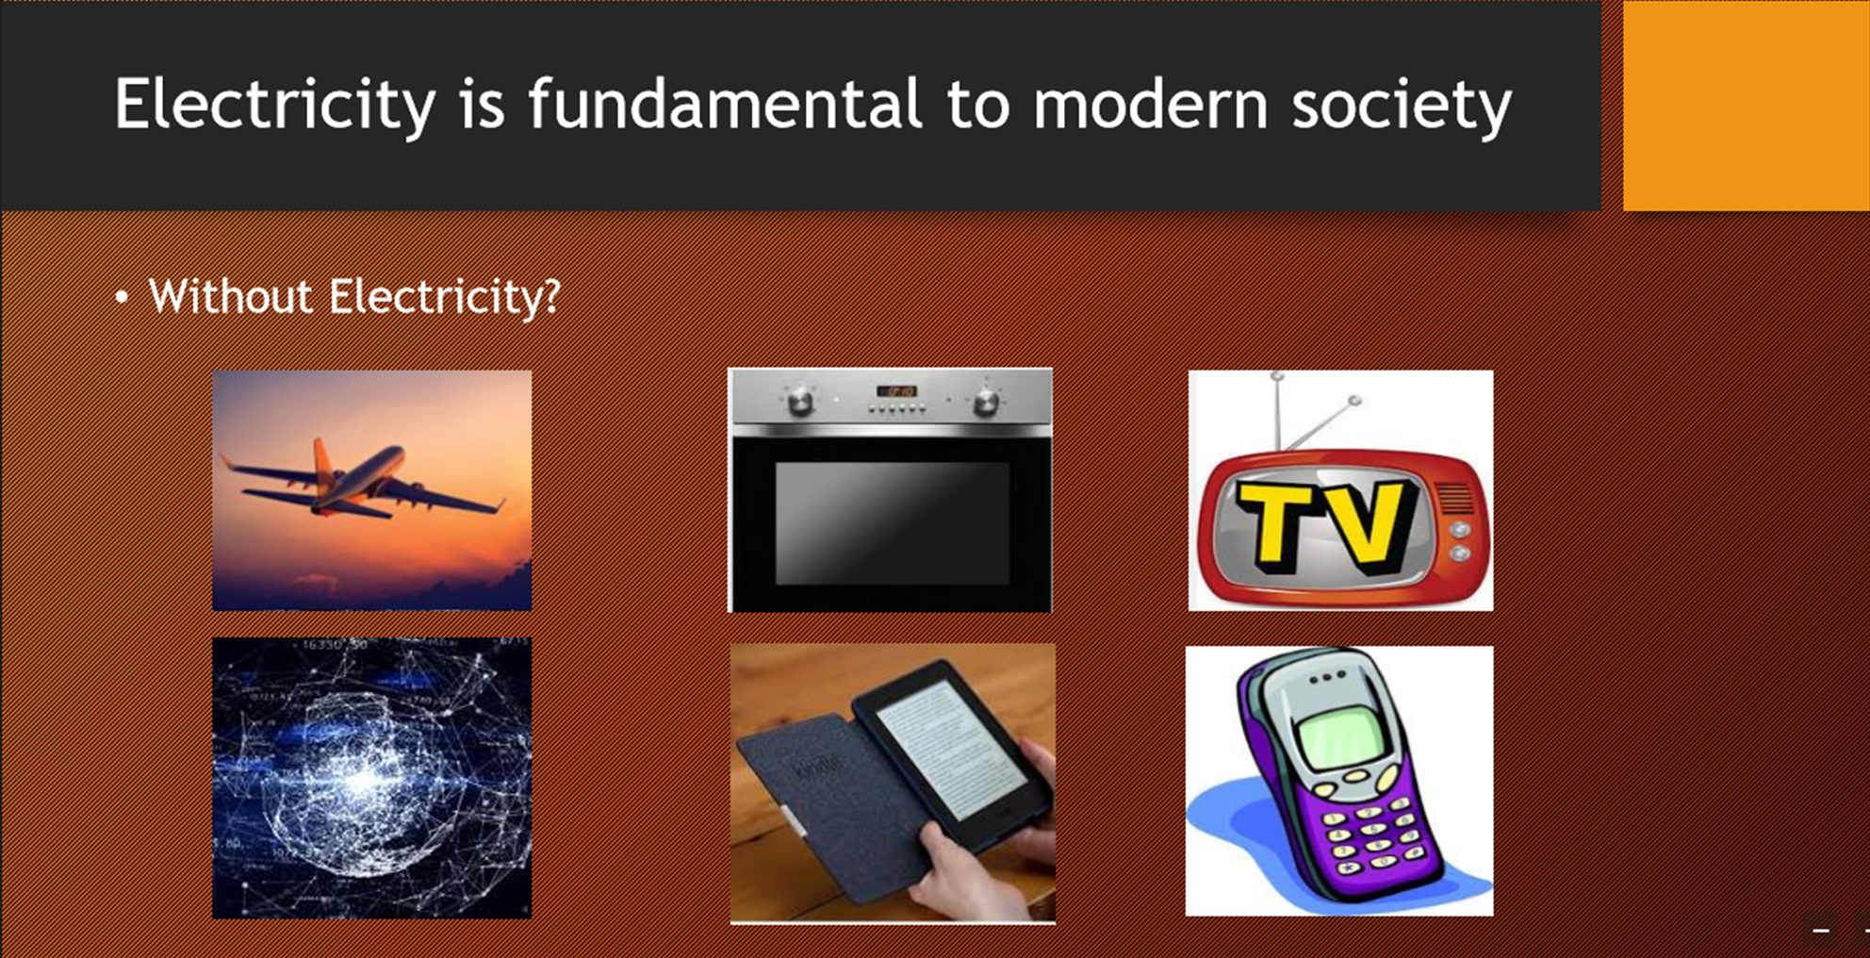

Slide 6
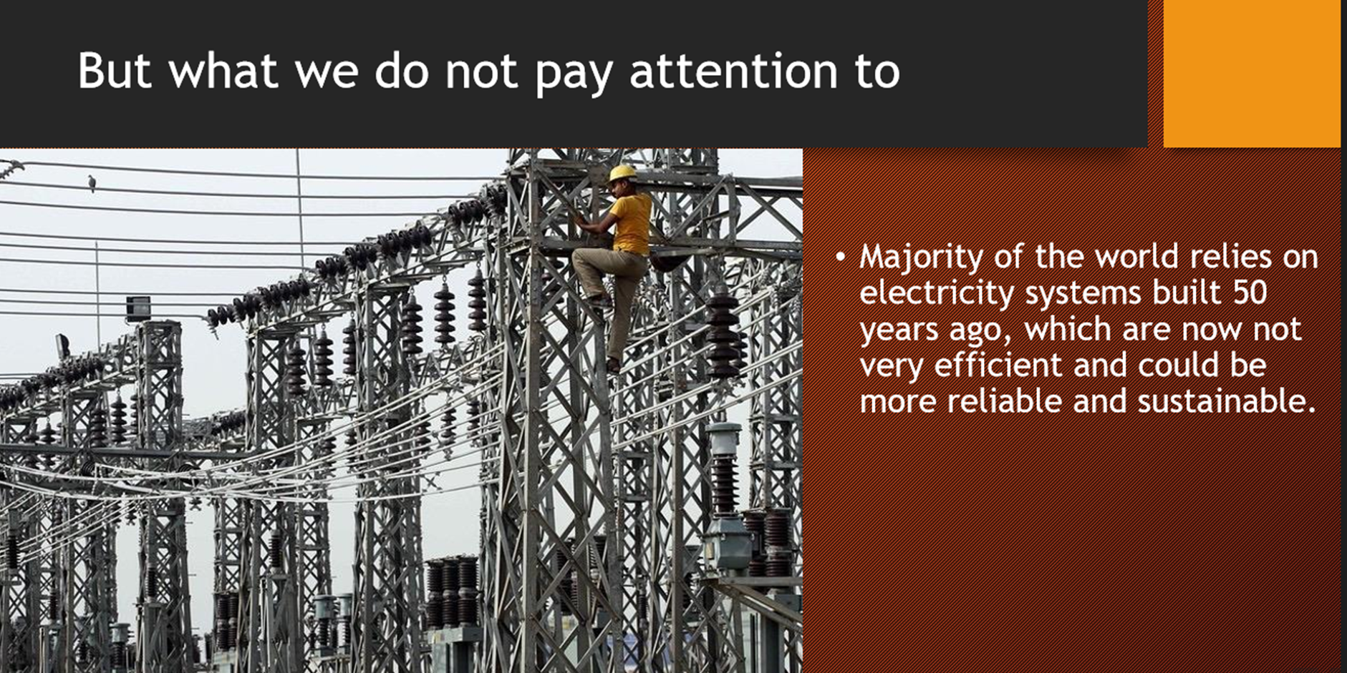

Slide 7
Solution: SMART GRIDS
Smart grid is define as a modernized electrical grid that uses information and communication technology to collect and act on information to provide an automated, reliable, efficient and cost effective way to produce and distribute electricity.

Slide 8
INTRODUCTION
Older electric grids were design to meet the requirement of power systems centuries ago!
however with today’s demands and requirements for both present and future planning, the capability of older electric grids has become limited. In order to meet the demands and requirements the idea of combining power systems with networking to provide a much more intelligent system has been one of the main goals within the area of energy.

Slide 9
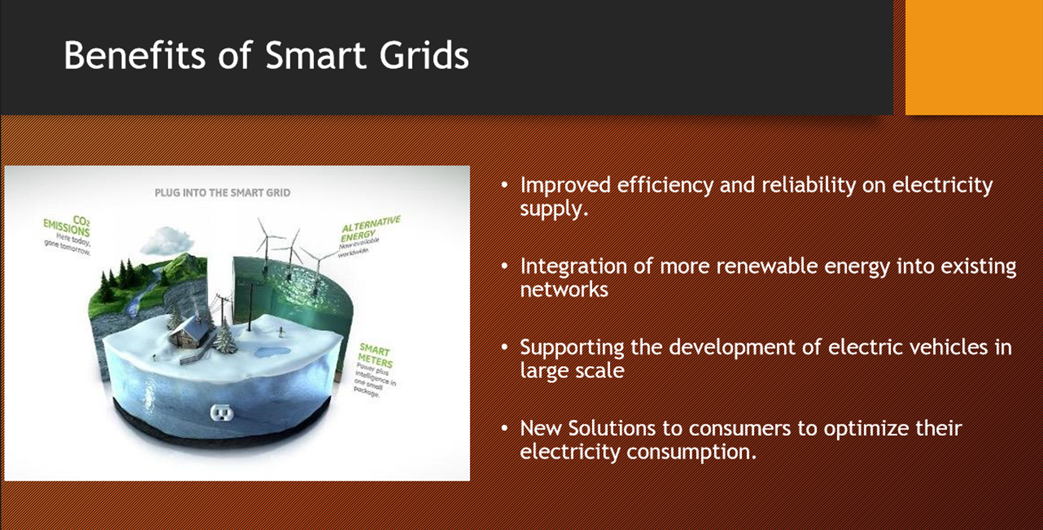

Slide 10
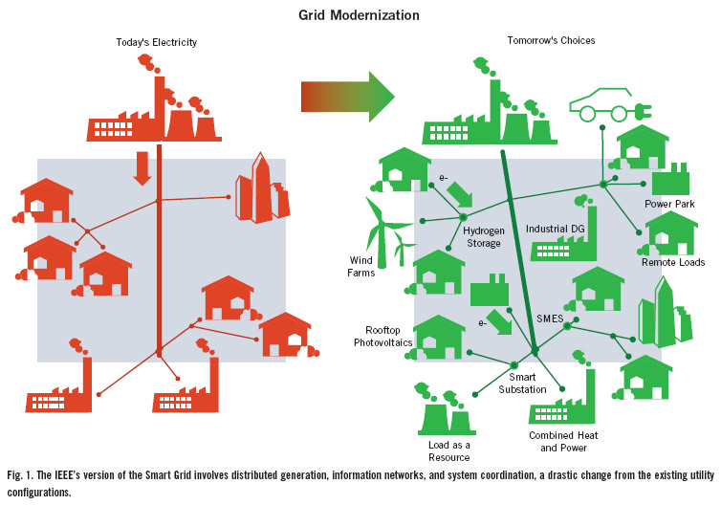

Slide 11
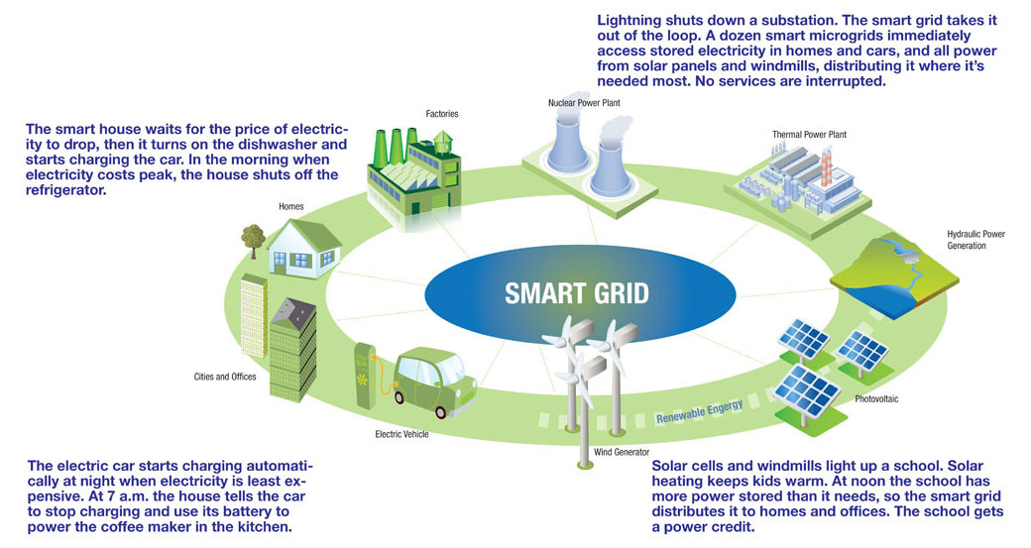

Slide 12
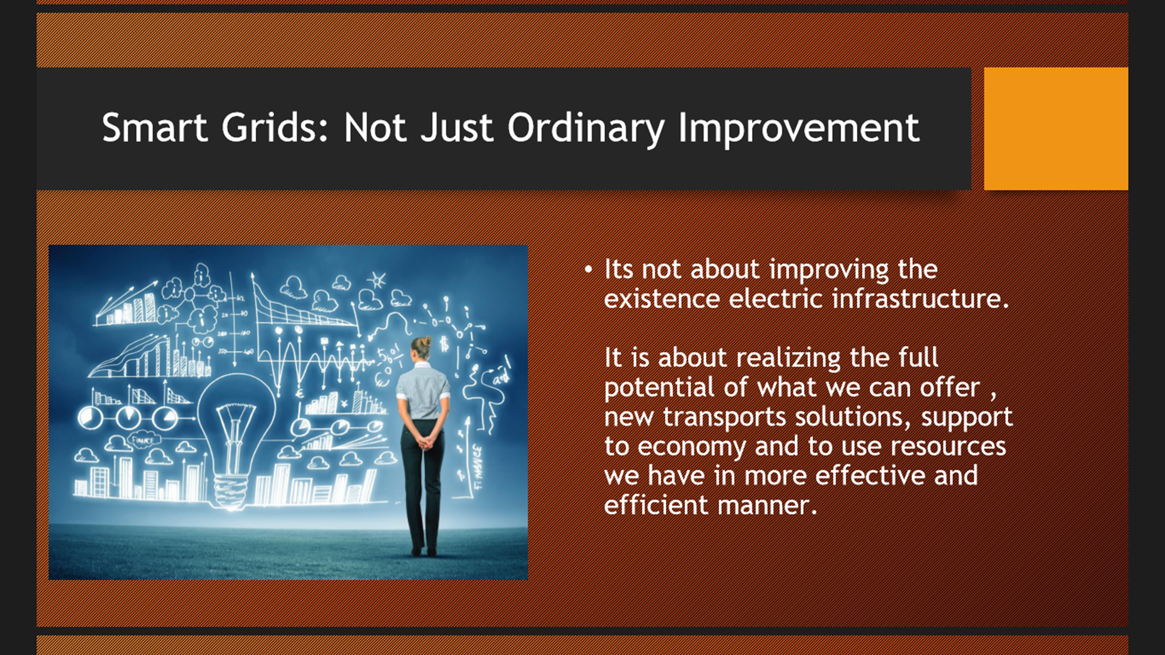

Slide 13
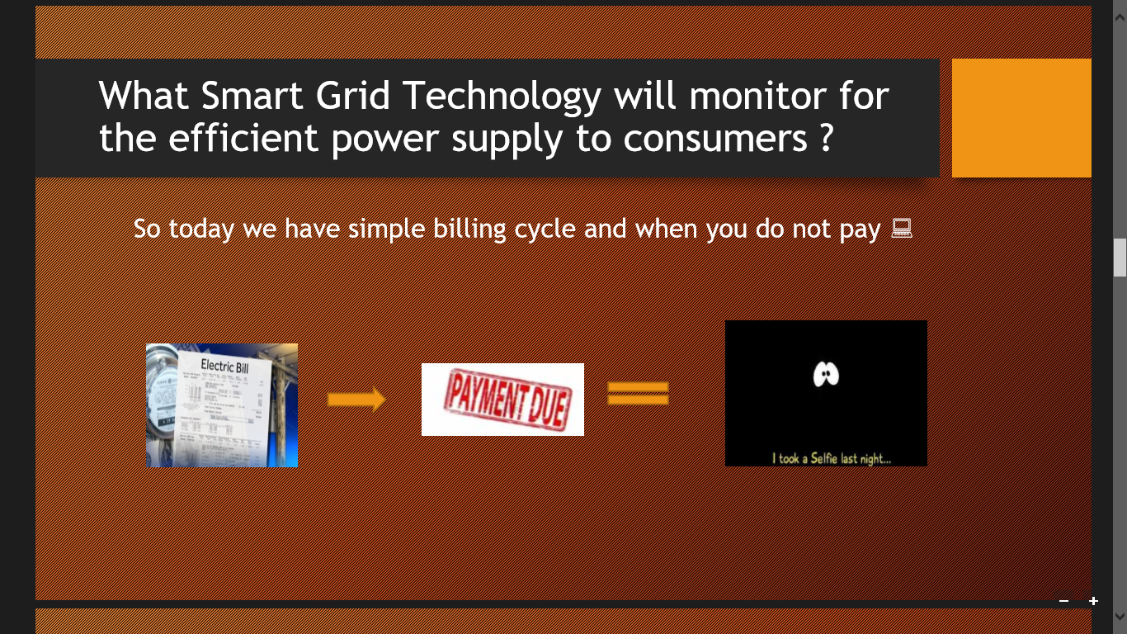

Slide 14


Slide 15
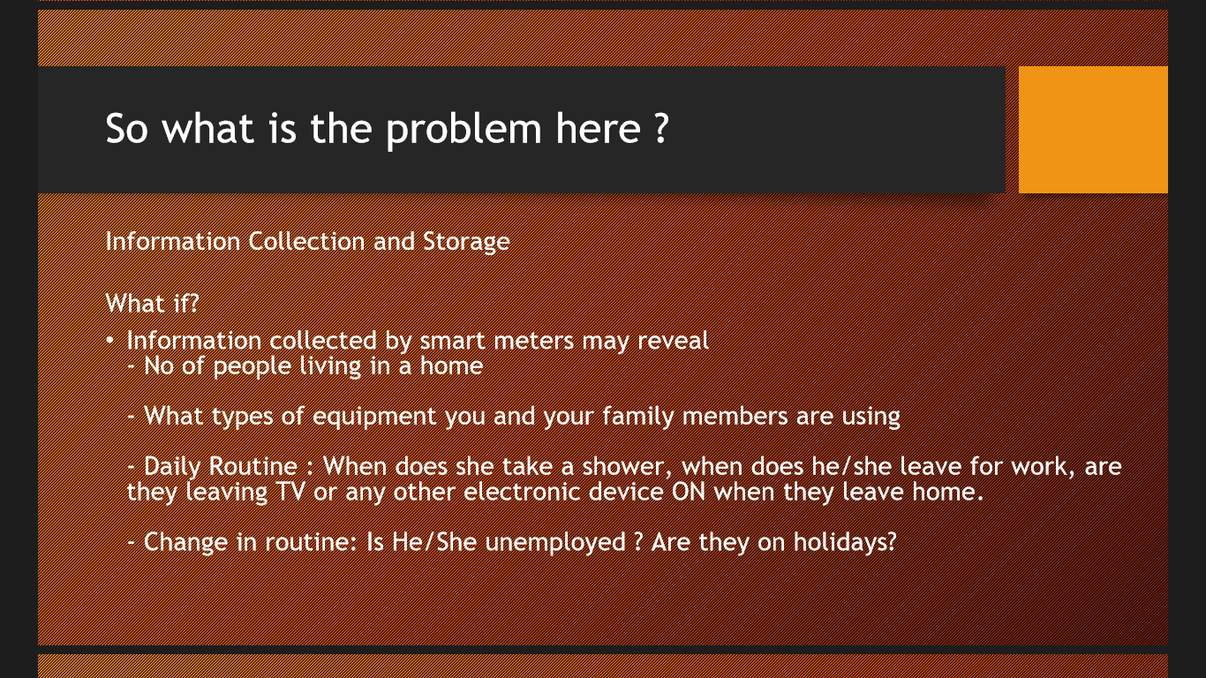

Slide 16
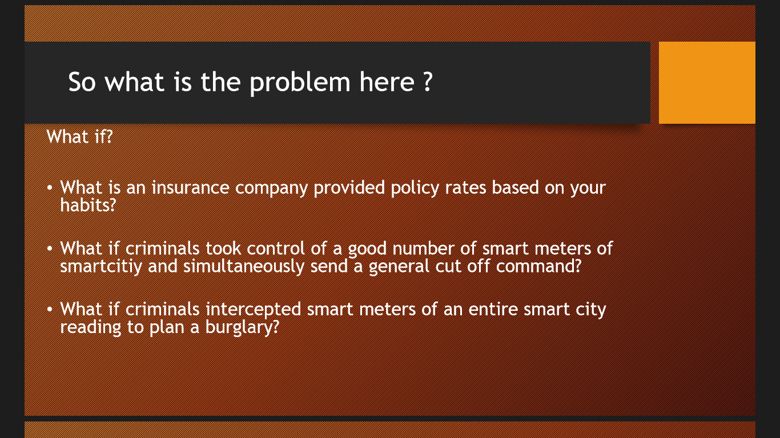

Slide 17
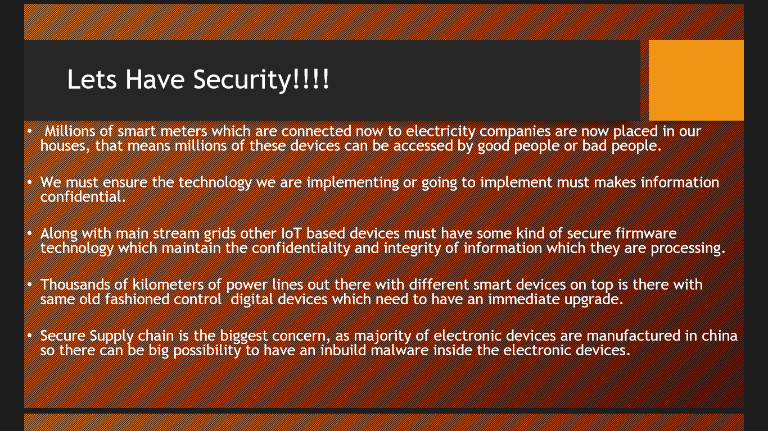

Slide 18
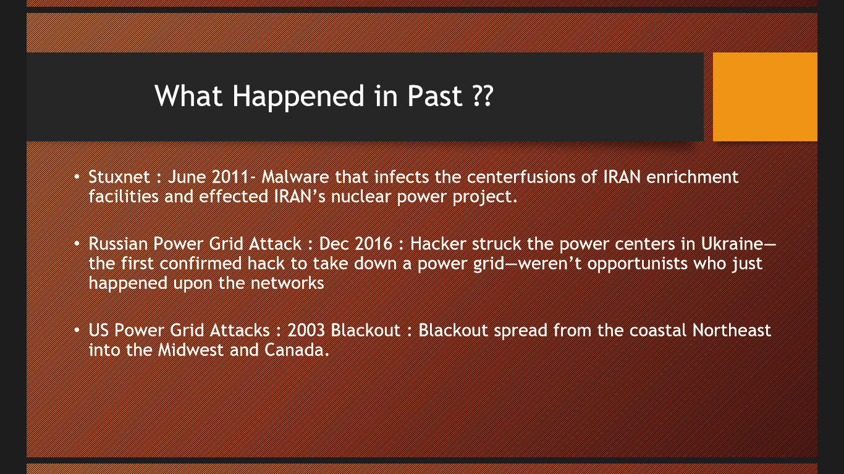

Slide 19
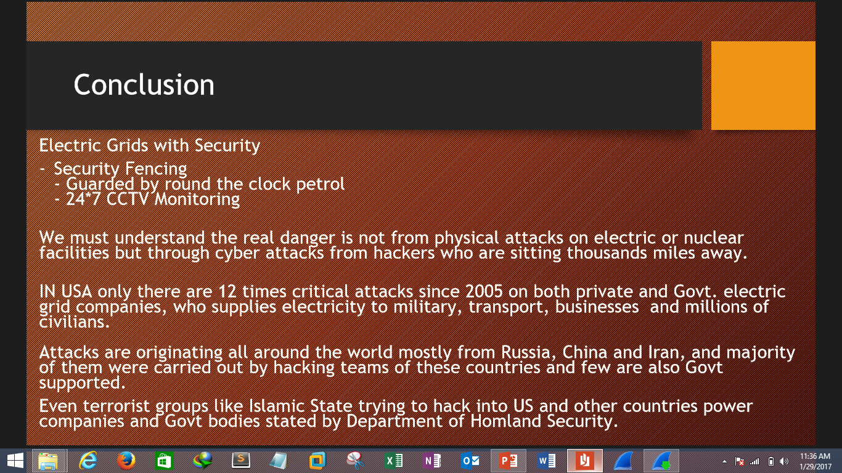

Slide 20
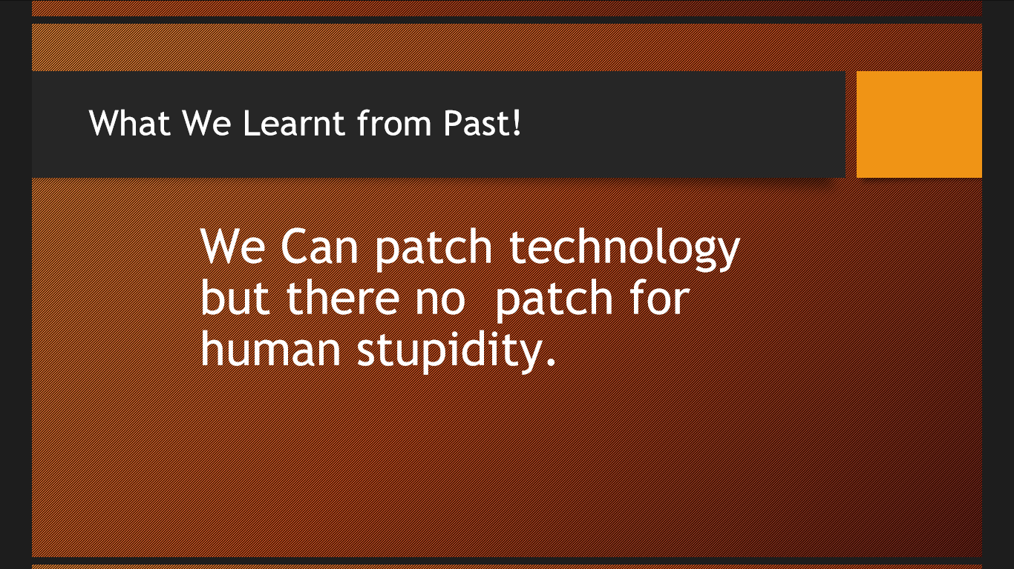

Slide 21
GOALS
Intelligent :Ability to respond intelligently to problems.
Efficient : Capable of meeting demands of consumers
Green: must work in favor of improving the environment
Motivating : allows two way communications between consumer and utility
Opportunistic : an opening of new opportunities and markets for new
innovations.
Accommodating: must be accepting of all forms of energy production and distribution
Resilient : serves as a firewall to attacks and natural disasters as system
becomes decentralized and reinforced with smart grid security protocols

Slide 22
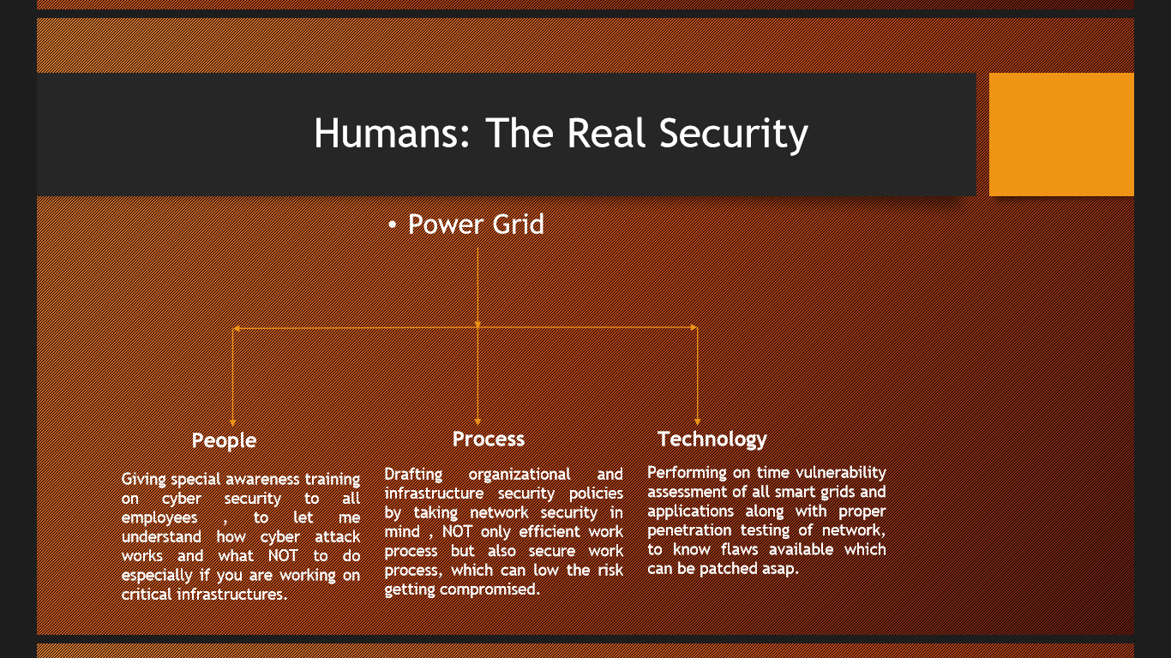

Slide 23


Slide 24
Thank you
ANY QUESTION?

